Slide 1
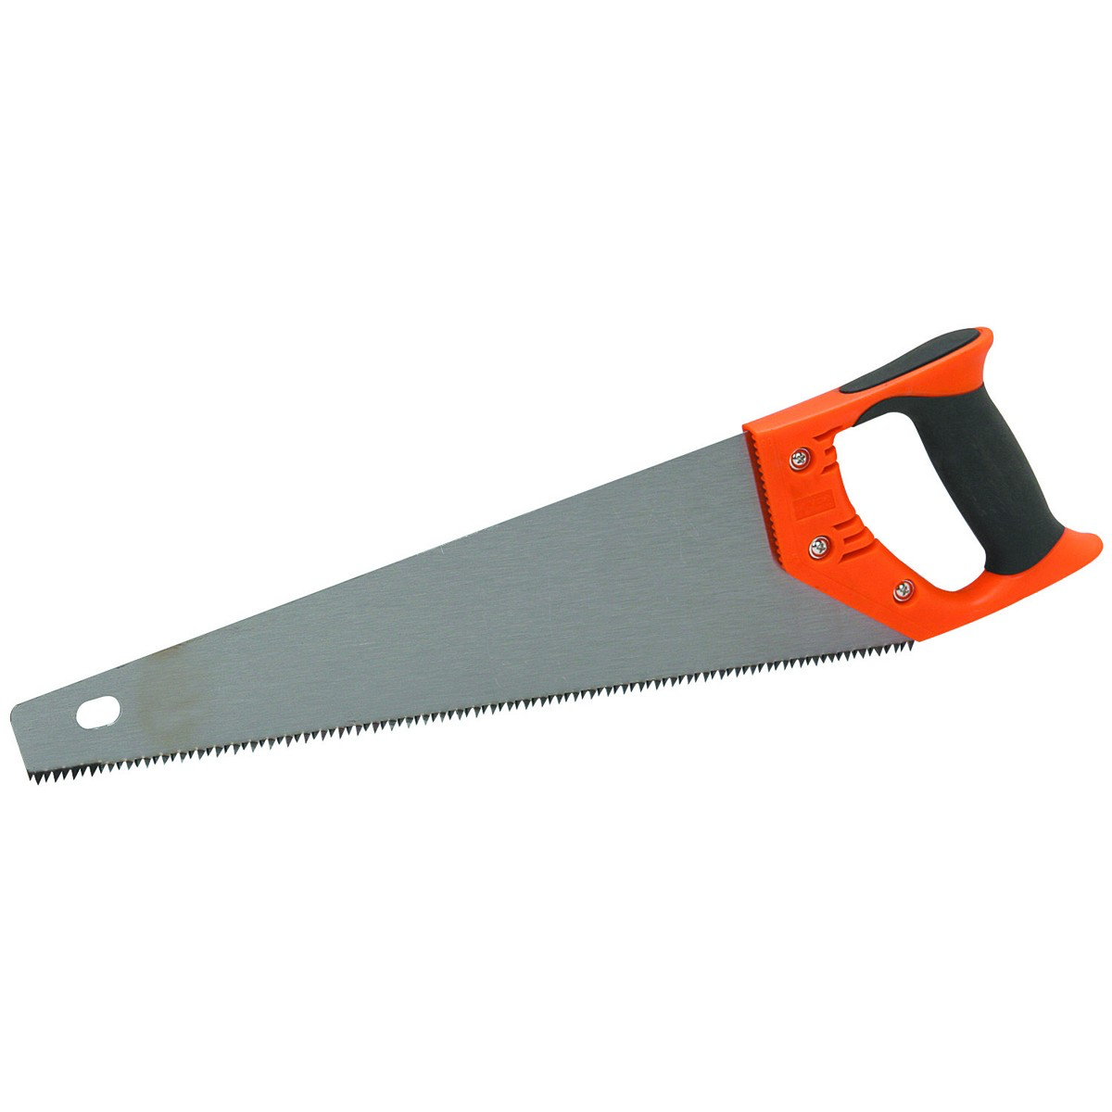
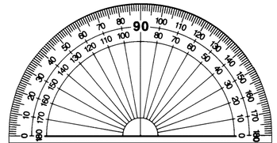
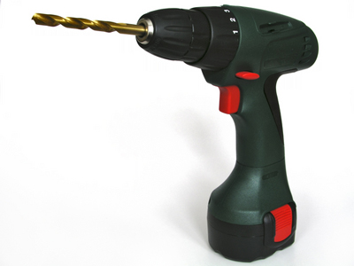
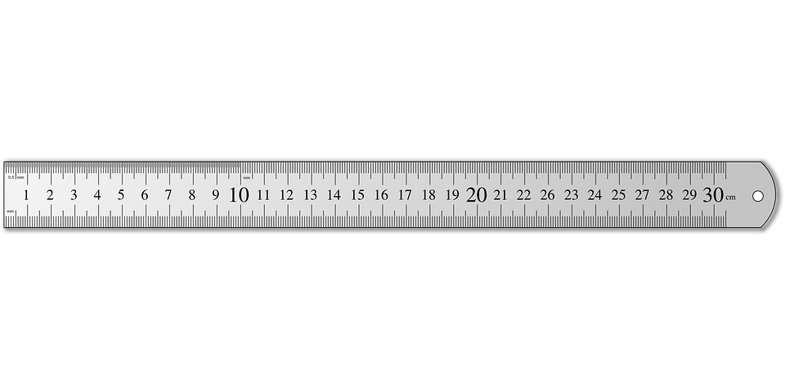
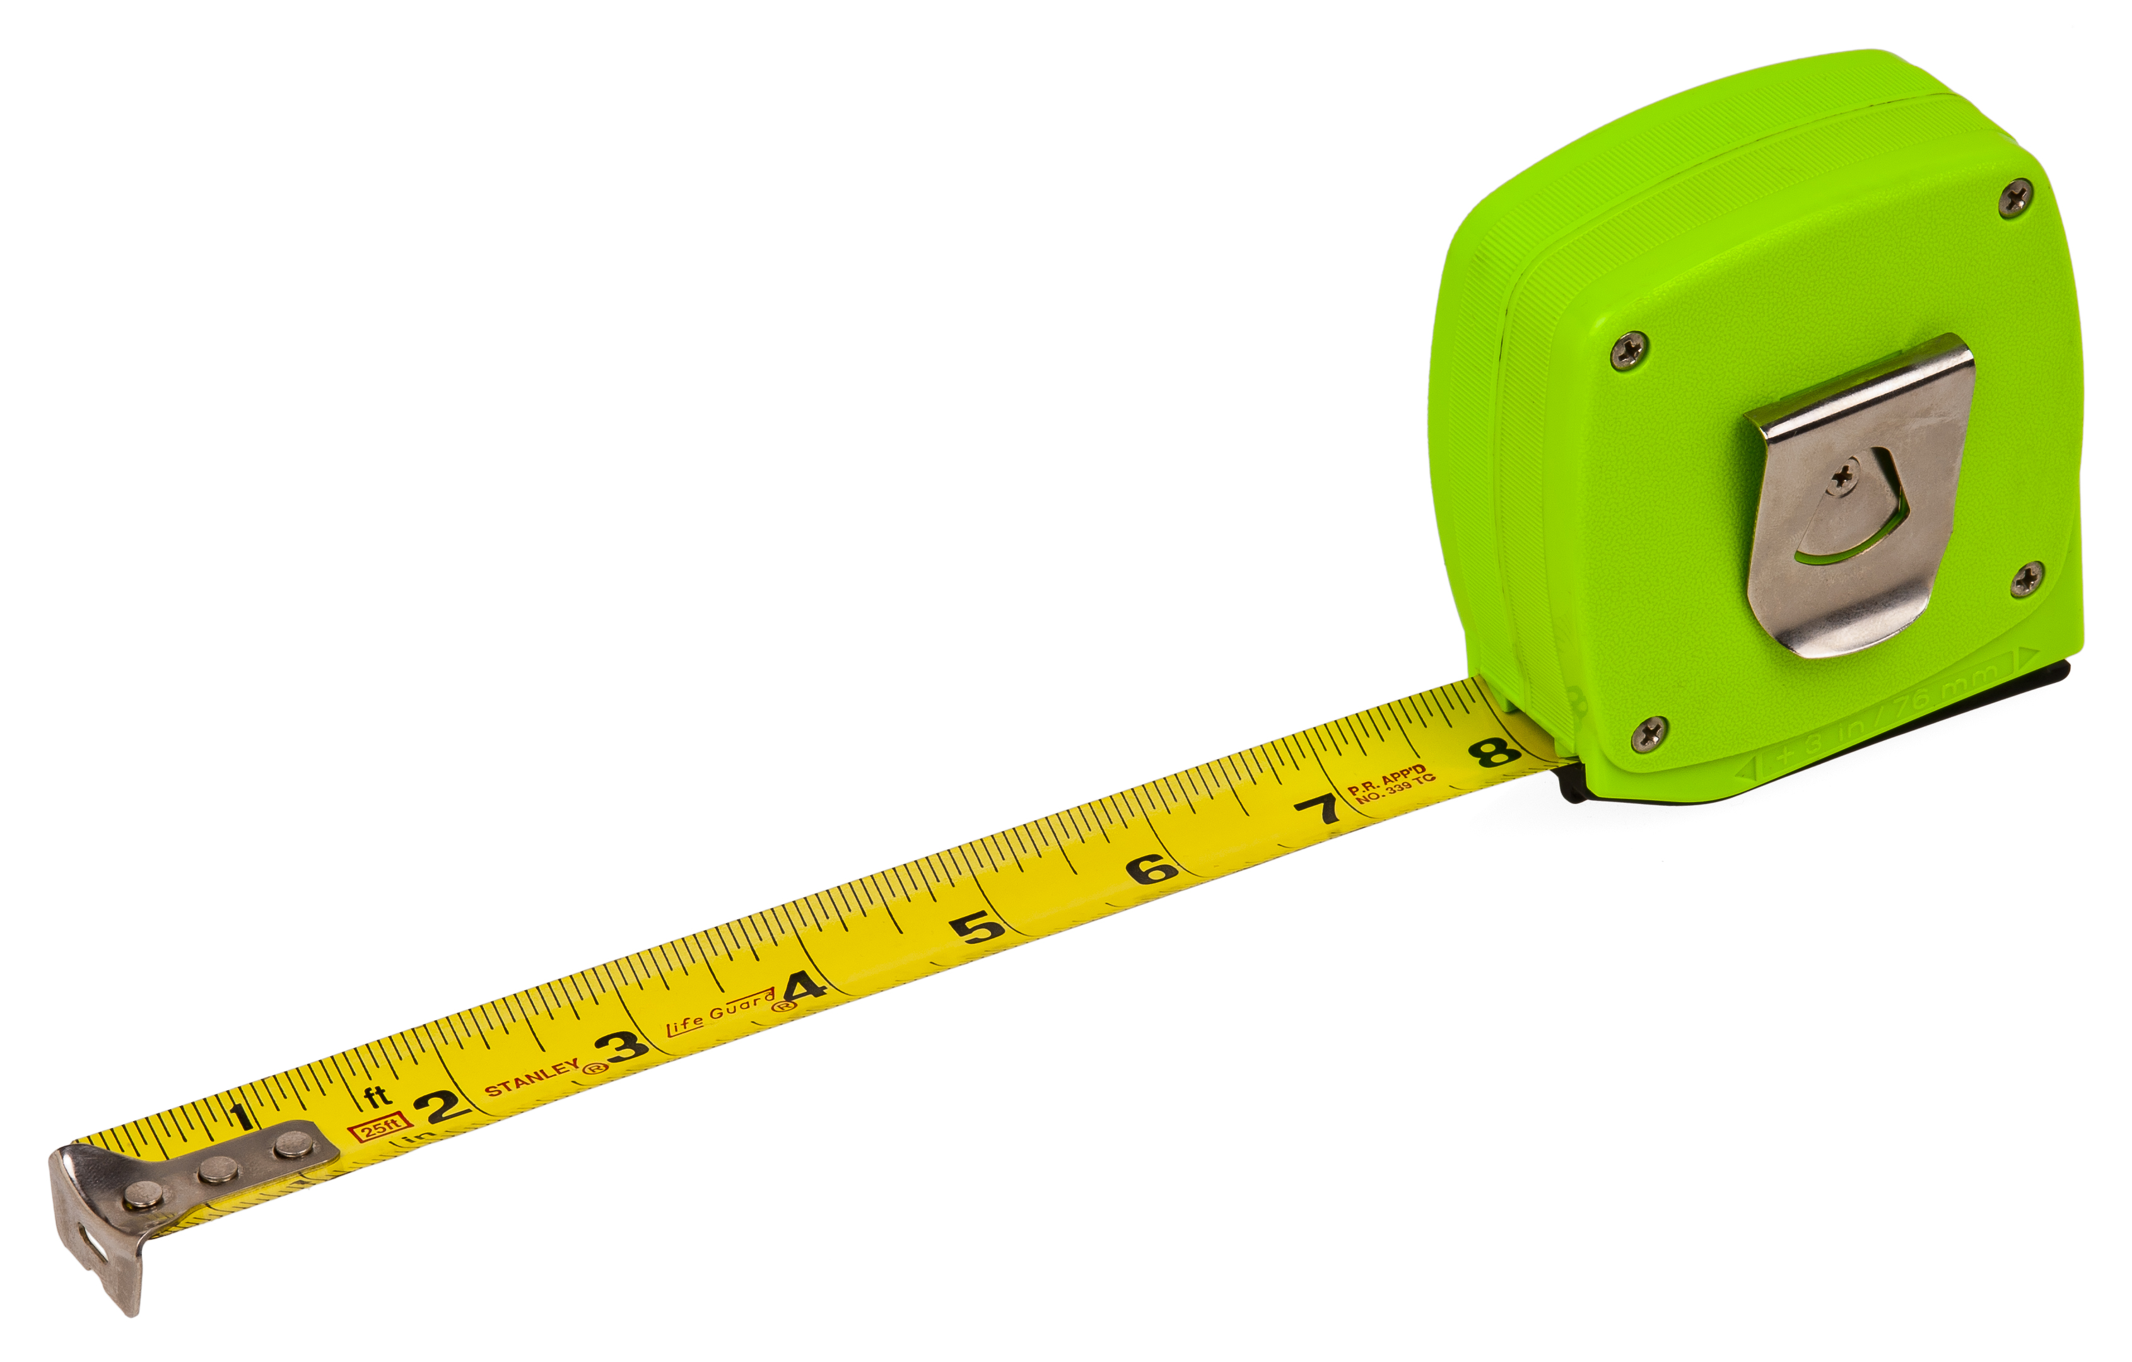
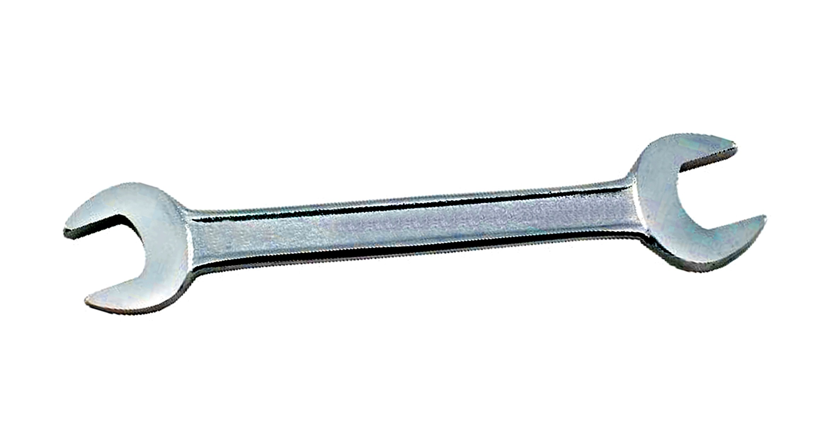
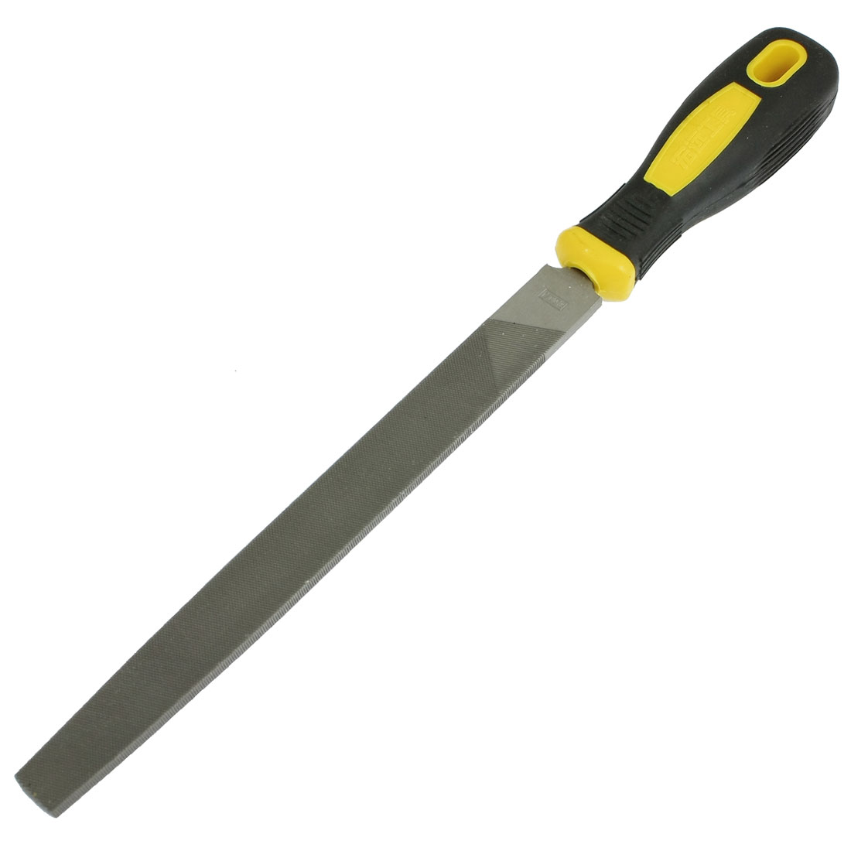
Tools Required
Saw |  | Protractor
Hand Drill |  | Ruler
Spanners (8mm) |  | Tape Measure
File

Slide 2
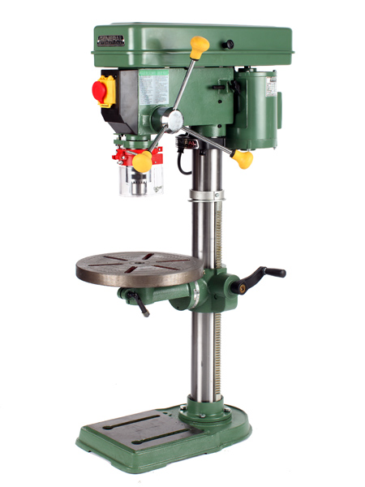
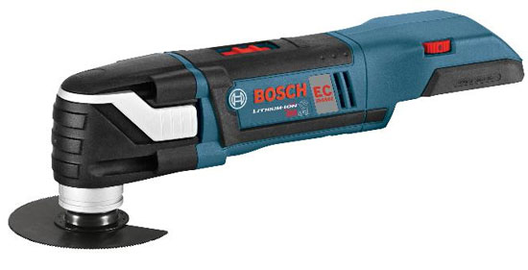
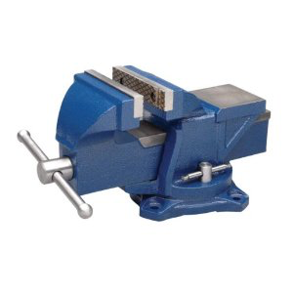
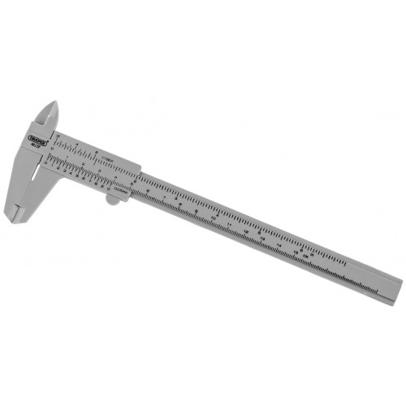
Optional Tools
Drill Press
Power Saw
Bench Vice
Callipers

Slide 3
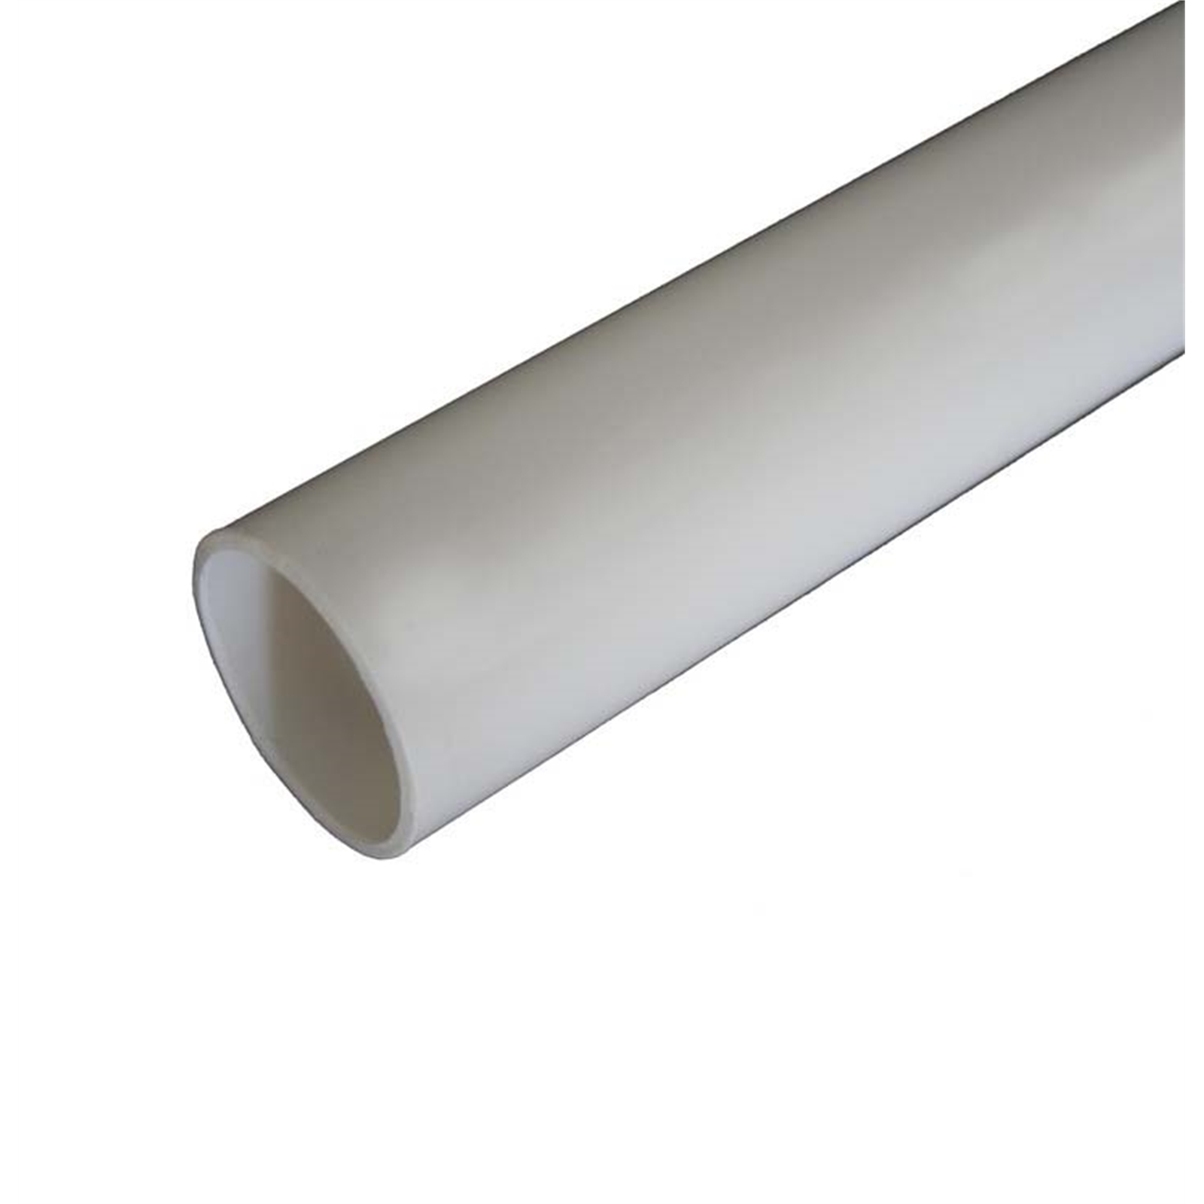
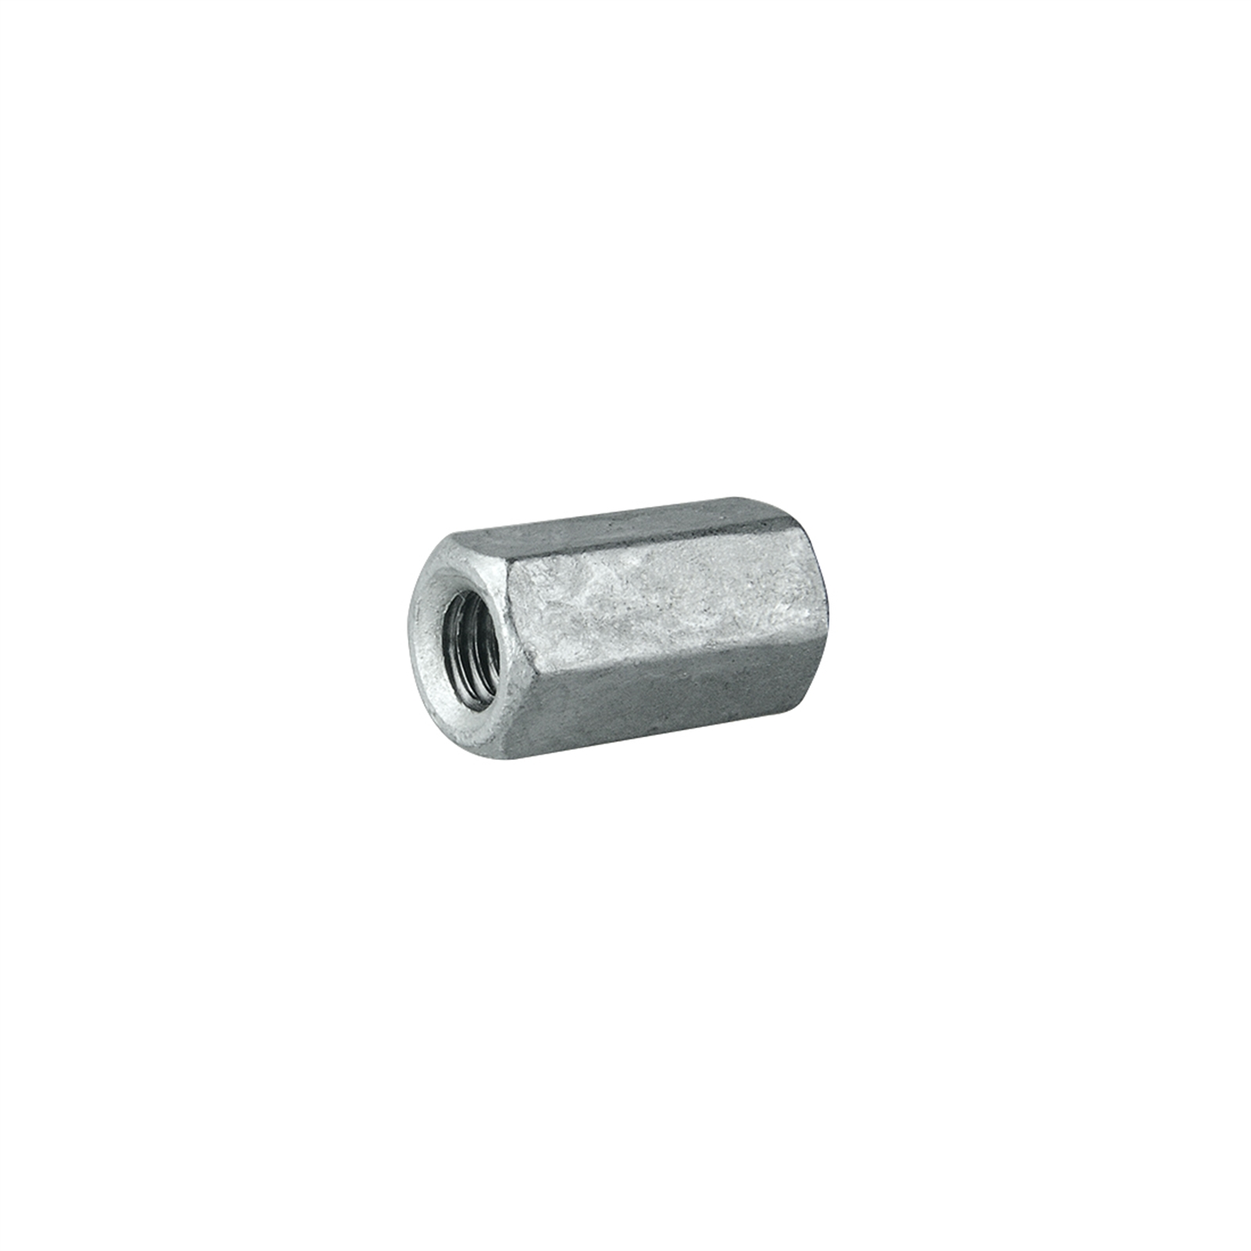
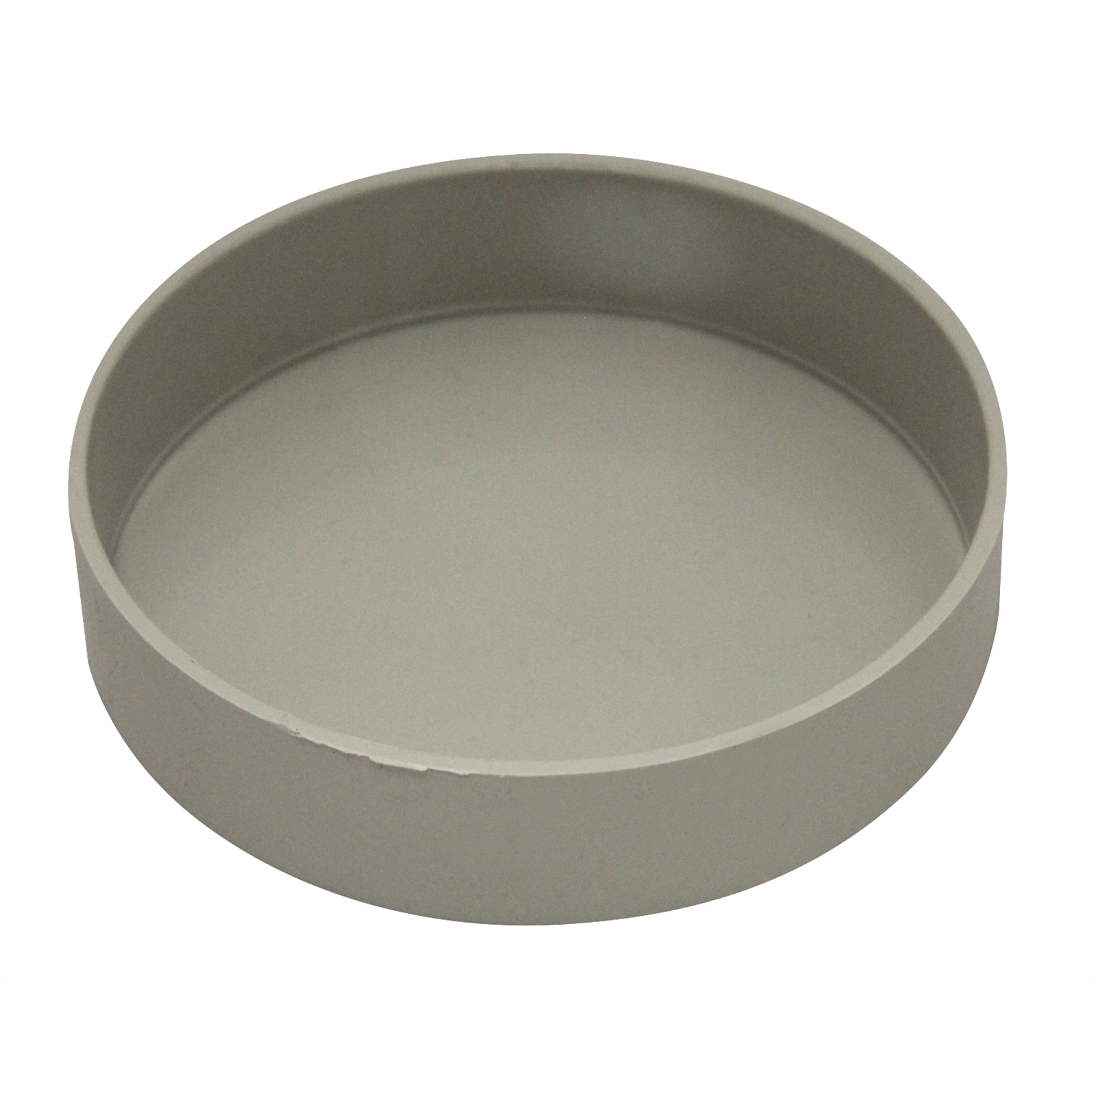
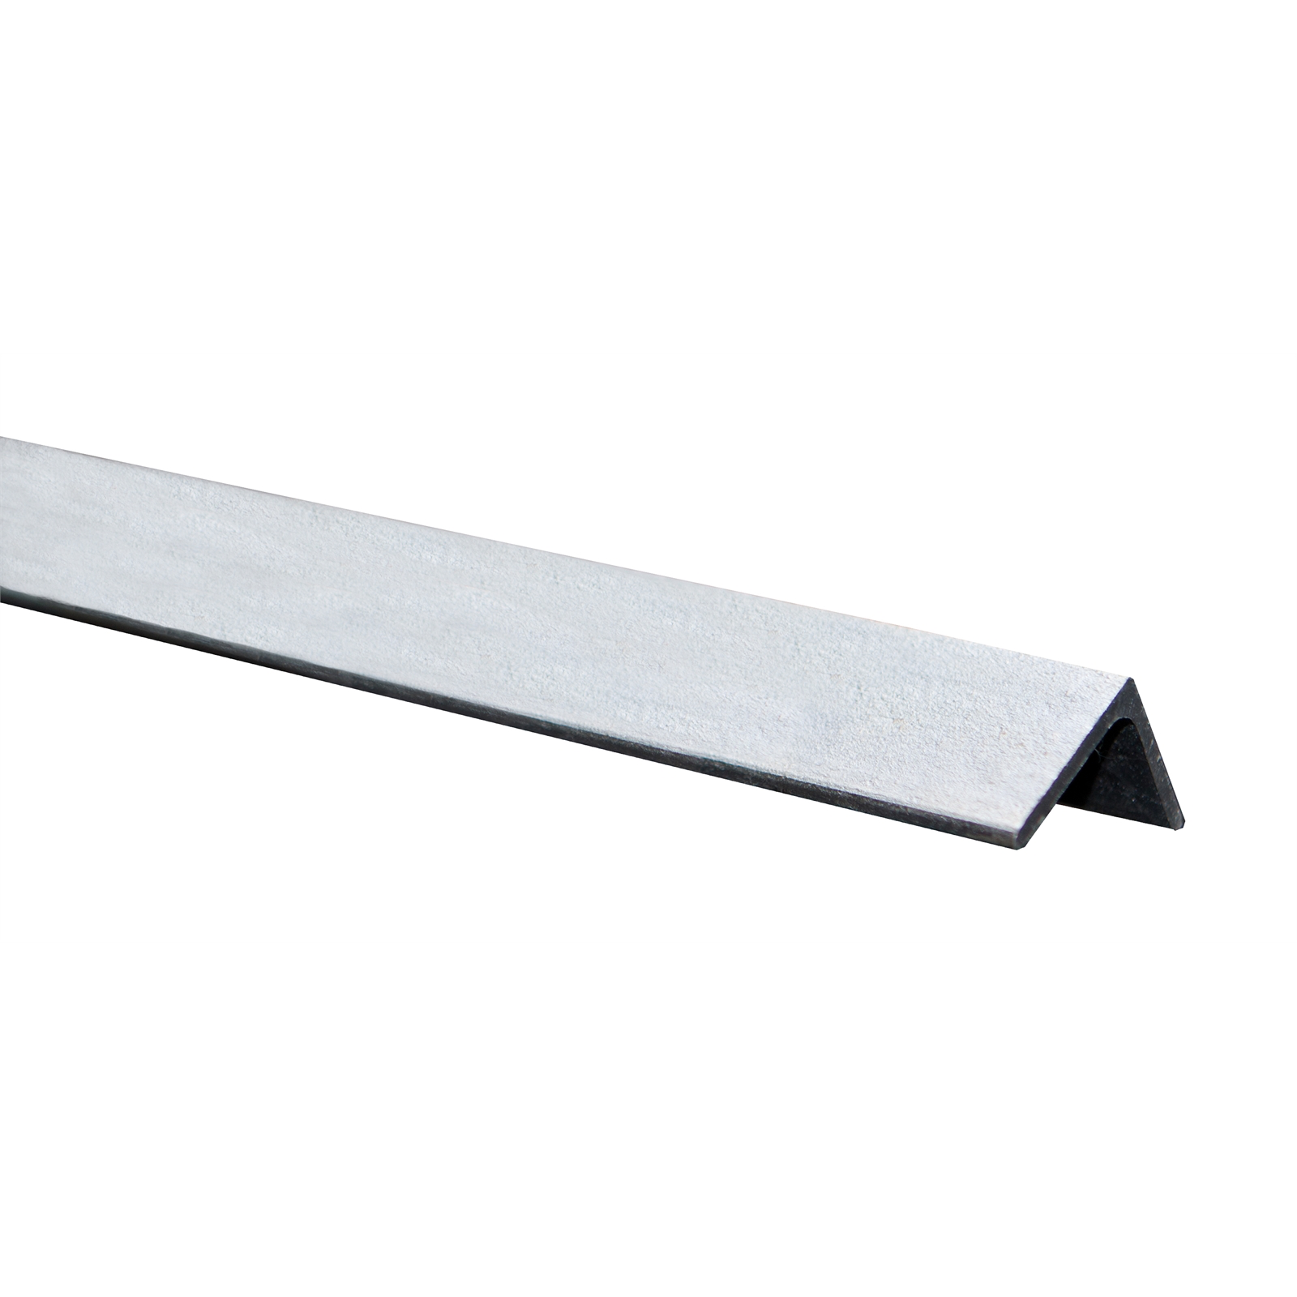
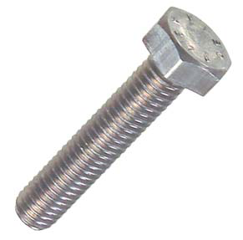

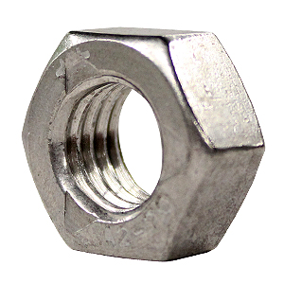
Materials
90mm PVC pipe (1m length) | x1 |  | M16x60mm threaded coupling | x1
100mm PVC end cap | x1 |  | 12x12x1.4mm Angle Iron (0.5m long) | x1
Bolts: M5x25mm M16x100mm | x10 x1 |  | Threadlock | x1
Nuts: M5 M16 | x10 x1

Slide 4
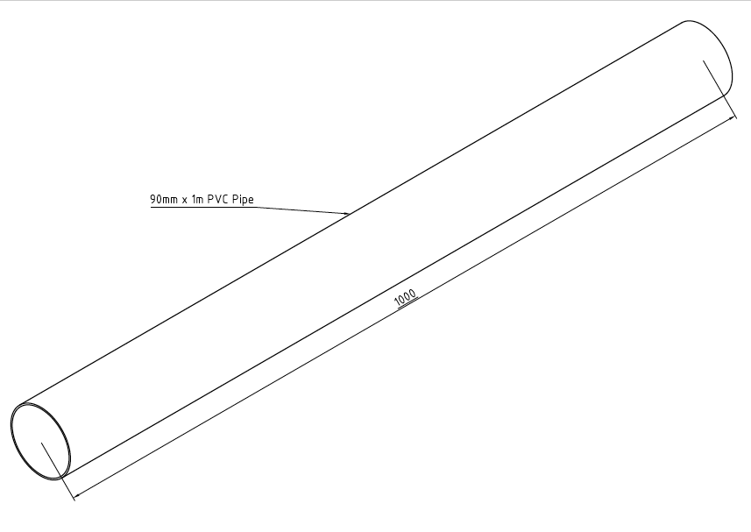
PVC can be a great material to make wind turbine blades. It is cheap, light and readily available at most hardware stores. To make blades that are 500mm long, you will want to start with a 1m length of 90mm PVC, which is approximately 2mm thick.

Slide 5
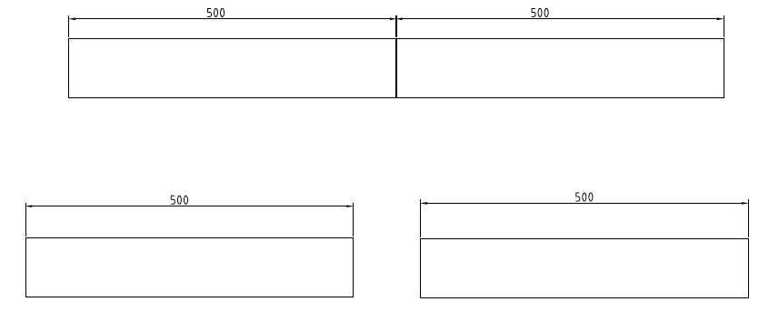
Measure and mark off 500mm from the end of the pipe. Then carefully cut through to make two equal lengths.

Slide 6
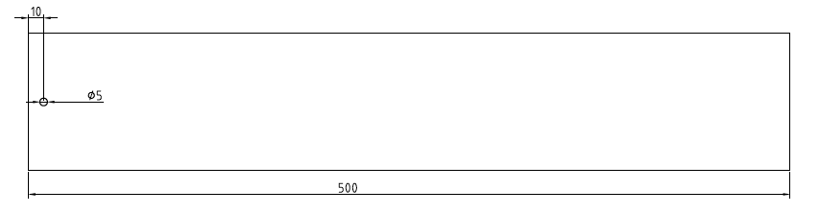
Drill a 5mm hole, 10mm from one end of the pipe. Rotate the pipe 90 degrees and repeat three more times to give a total of four holes.

Slide 7
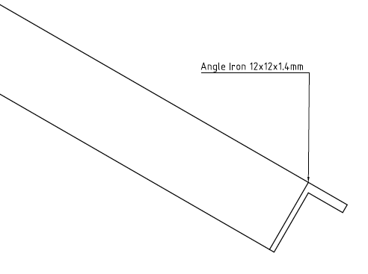
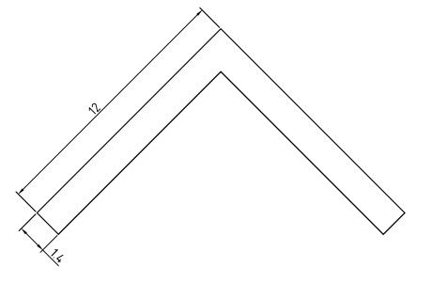
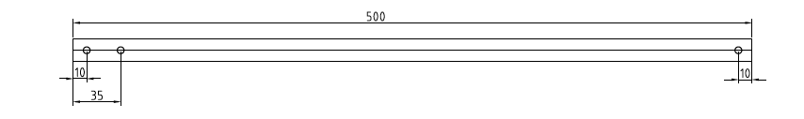
Drill three holes in the centre of the angle iron as shown here:

Slide 8
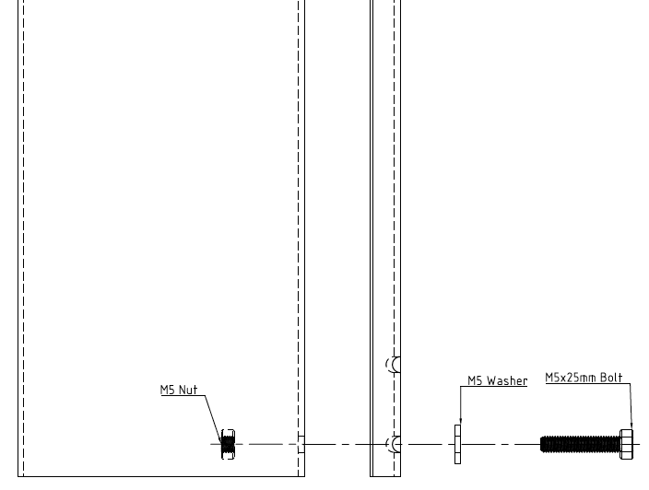
Loosely fasten the angle iron to the pipe using an M5 nut, bolt and washer. Lay the angle iron straight down the length of the pipe.

Slide 9
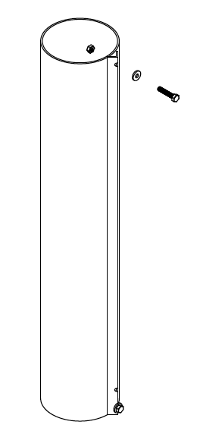
Line up the angle iron straight down the pipe and use the holes in the angle iron to drill two more holes in the PVC pipe.
Fasten down the other end of the angle iron with another M5 nut, bolt and washer. Make sure the angle iron is straight and the bolts are tight.

Slide 10
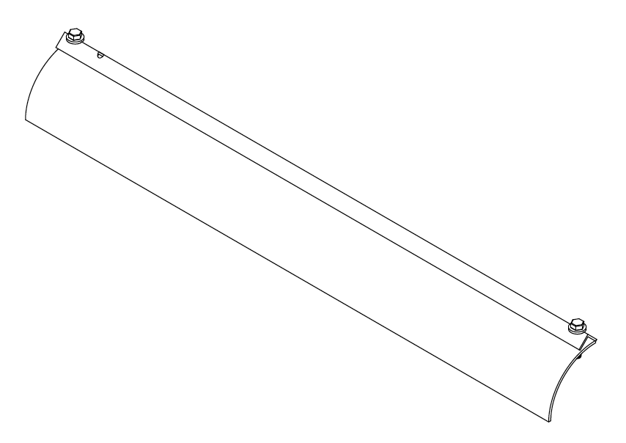
Use the angle iron to make a straight cut down the pipe. Repeat this process until the pipe is in quarters.

Slide 11
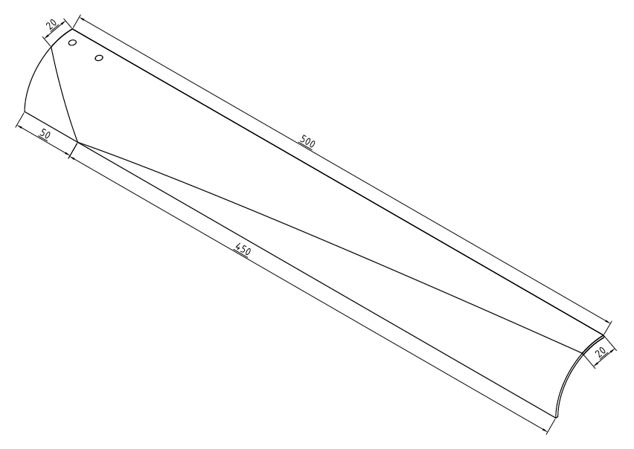
The next step is shaping the blades. We find that the following dimensions work quite well:

Slide 12
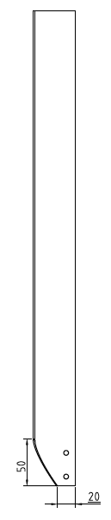
First we cut the ‘root’ of the blade. This is the end where the blade will be attached to the generator.
Measure the root to be 20mm wide and then mark off a point 50mm from the end. Using sticky tape, join these two parts with a straight line and make a cut to shape the blade.

Slide 13
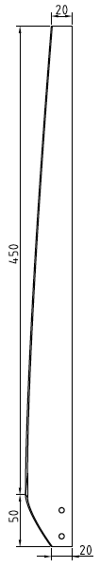
Repeat this process for the blade ‘tip’ using the dimensions shown. Note that it is difficult to cut accurately due to the shape of the blades, and so it is recommended to cut less than you think and then use a file and sandpaper to finish.

Slide 14
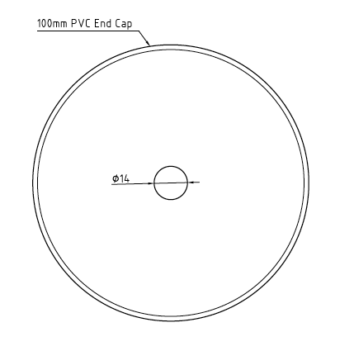
Find and mark off the centre of the 100mm PVC end cap. Use this mark to drill out a 14mm hole.
There may be a centre mark from manufacturing, but if this is difficult to find, see this guide for finding the centre of any circle: http://www.instructables.com/id/How-to-find-the-center-of-a-circle/

Slide 15
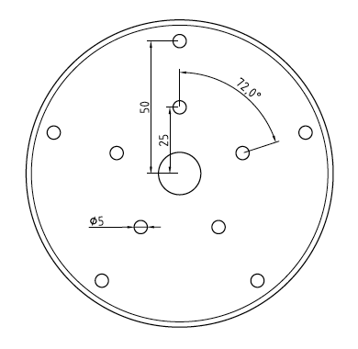
Using a protractor and ruler, mark out and then drill 5mm holes to attach the blades according to these dimensions.

Slide 16
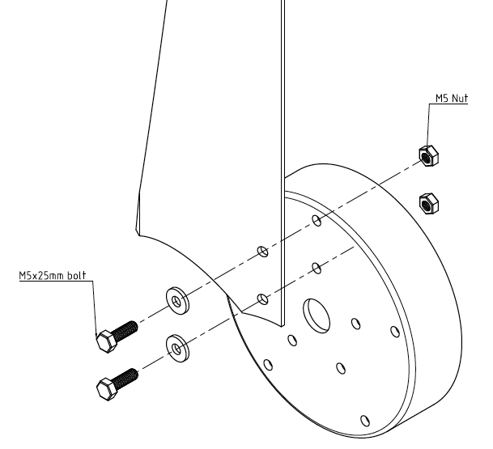
Attach each blade using 5mm bolts, washers and nylon locking nuts.

Slide 17
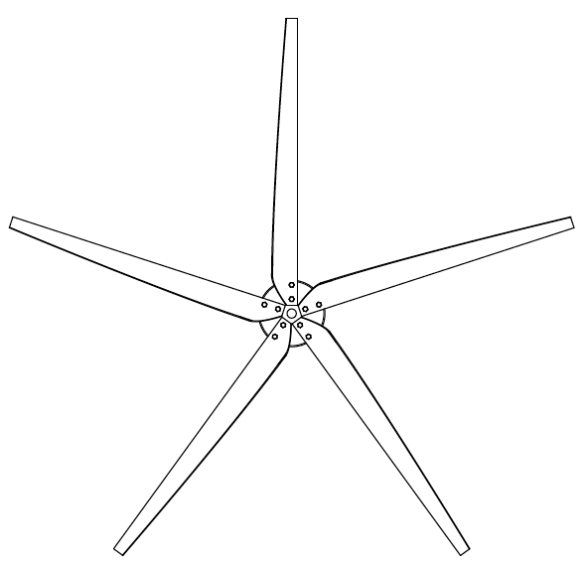
Once all five blades are attached, take a minute to check that they all look even and straight.

Slide 18
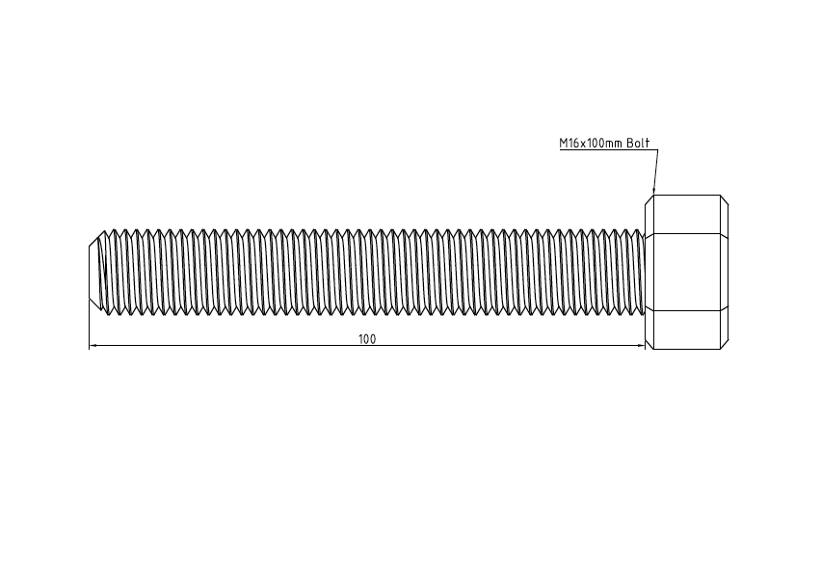
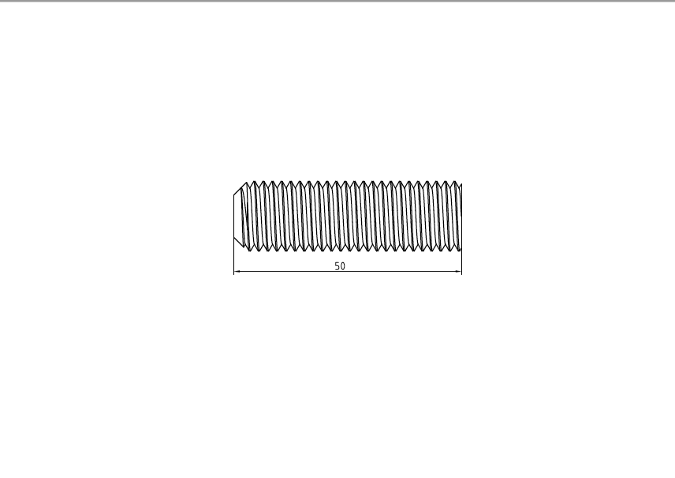
Cut off a 50mm length of the threaded shaft from an M16 bolt.

Slide 19
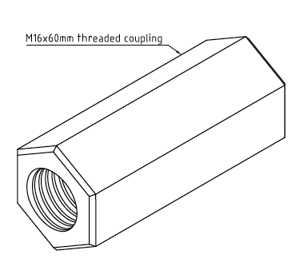
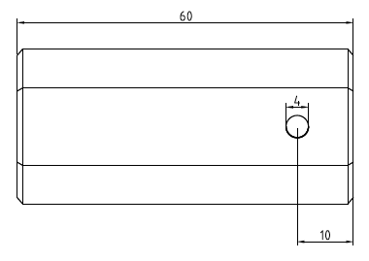
Drill a 4mm hole all the way through the M16 coupling, 10mm from one end.
Notes:
Add hole dimension to drawing
Add length dimension to view with hole
Add label to isometric view

Slide 20
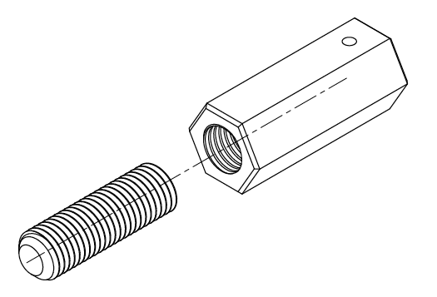
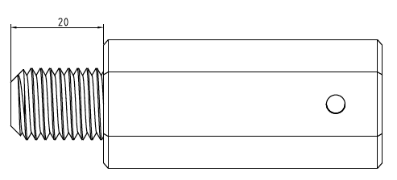
Apply superglue/threadlock and screw the M16 coupling and thread together so there is 20mm of thread exposed.

Slide 21
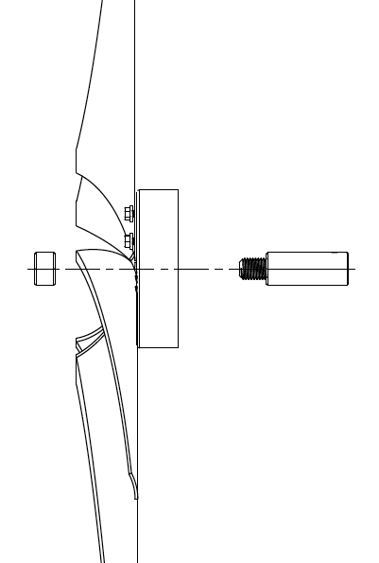
Fasten the whole blade assembly together, until really tight, using superglue or threadlock to hold the fasteners in place.

Slide 22
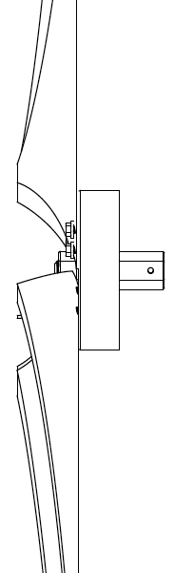
Marvel at your new blade assembly!

Slide 23
Using 5mm plywood, cut a rectangle measuring 200x300mm

Slide 24
Drill 2x 5mm holes according to the following dimensions

Slide 25
To make the tail boom we used a 500mm length of 45mm Aluminium Box Section

Slide 26
Drill 2x 5mm holes all the way through:
Rotate the piece by 90 degrees and drill two more holes at the other end.

Slide 27
Fasten the tail boom to the tail fin using M5x35mm fasteners.

Slide 28
To build this wind turbine, we used an old treadmill motor that looks like this. Although the rest of these directions assume that you are using the same motor, it is possible to adapt them to suit your own motor. For a guide on whether or not your motor is suitable for electricity generation, see our guide here: www.leproject.org/wind-turbine-motor-guide

Slide 29
Drill a 4mm hole in the flat side of the motor shaft, 15mm away from the motor body.

Slide 30
Next we need a way to fasten the motor down. Cut a piece of 5mm plywood to this size.

Slide 31
The holes to mount our motor are ½ inch diameter (approx 12.5mm), so we need to drill 4 holes to match. The hole in the middle is just so that the wires can pass through.

Slide 32
We also need to drill the base plate to attach an off-the-shelf 15mm pipe flange.

Slide 33
To match the flange, drill 4x 7mm diameter holes according to these dimensions.

Slide 34
Fasten the base plate to the pipe flange using M7x20mm bolts, nuts and washers.

Slide 35
Fasten the motor to the base plate assembly using ½”x1.5” bolts, nuts and washers.

Slide 36
To keep the motor protected from rain, we use a threaded section of 150mm PVC and end cap.

Slide 37
We need to drill holes to allow the shaft to pass through, and to mount the tail assembly.

Slide 38
The hole in the end cap is slightly off-centre due to the dimensions of the motor. To ensure it is drilled in the correct place, first fasten the end cap to the coupling and take note which direction the end sits when fully secure. Mark out a vertical line to make it clear.

Slide 39
Measure 88.5mm from the bottom of this vertical line and drill 20mm hole for the motor shaft to pass through.

Slide 40
Fasten the end cap and the coupling together.

Slide 41
Fasten the tail assembly to the threaded access coupling using M5x35mm bolts.

Slide 43
Screw the 15mm pipe into the flange as tight as possible. Note that the bolts will prevent the flange from sitting on the PVC, but this isn’t a problem!

Slide 44
Cut out a 20mm square section from the edge of the non-threaded PVC end cap.

Slide 45
Push the PVC end cap onto the back of the coupling. You should have tight fit and so don’t need to use any fasteners.

